Slide 1
Protein sources
Chapter 3

Slide 2
Protein sources
Proteins may be :
Extracted from their naturally producing source material, such proteins are called ‘homologous’ proteins
Produced via recombinant DNA technology (recombinant protein production), often termed ‘heterologous’ proteins.
Advances in molecular biology and the ‘omics’ era rendered recombinant-based protein expression the more usual means of protein production.

Slide 3
Recombinant versus non-recombinant production
Recombinant Protein production has a number of advantages over direct extraction from a native source material:
Overcomes problems of source availability.
Overcomes problems of source safety.
Facilitates predefined modification of the protein’s amino acid sequence.

Slide 4
Recombinant versus non-recombinant production
Some proteins obtained by direct extraction from their native source for many reasons, including the following.
Some proteins are produced by native production sources at very high levels.
Some proteins, when expressed in recombinant systems, accumulate in a partially/fully unfolded, biologically inactive.
Some proteins can be quite toxic to the recombinant cells in which they are being produced.
Production in a recombinant system can influence specific post-translational modifications (PTMs) associated with a protein.
Public resistance to the use of recombinant products for industrial applications (e.g. food processing),
Patent issues surrounding the recombinant production route.

Slide 5
Approaches to recombinant protein production
A wide variety of molecular biological approaches may be pursued in order to construct a recombinant protein source organism. The specific approach chosen will depend on a number of considerations, including:
How much information is already known about the protein
The ultimate use for which the protein is required (e.g. for research or for a specific commercial application)
To some extent the personal preferences of the genetic engineers developing the recombinant system.

Slide 6
Approaches to recombinant protein production

Slide 7
Approaches to recombinant protein production

Slide 8
Cloning the target gene
PCR allows the generation of multiple copies of the specific sequence encoding the target protein.
The PCR product is then generally inserted into a cloning vector.
The most commonly used vectors in conjunction with E. coli are plasmids.
Plasmids are circular extrachromosomal DNA molecules and generally house one or more genes whose product renders the plasmid-containing cell resistant to specific antibiotic(s).
One plasmid classically used in cloning experiments with E. coli is pUC18

Slide 9
Cloning vector features
Practical Features of DNA Cloning Vectors:
Size – small enough to be separated from chromosomal DNA of host plasmid
Origin of replication (ori) – site for DNA replication that allow plasmids to replicate independently from host chromosome
Copy number: number of plasmids in the cell (normally small but plasmids have high copy numbers)

Slide 10
Cloning vector features
4. Multiple cloning site (MCS) – recognition sites for several restriction enzymes in which insert is cloned into
5. Selectable marker genes – allow to select for transformed colonies
6. RNA polymerase promoter sequences – used for transcription in vitro and in vivo
7. DNA sequencing primers

Slide 11
Cloning plasmids
Polylinker site; is a site that contain many restriction sites (up to 20)

Slide 12
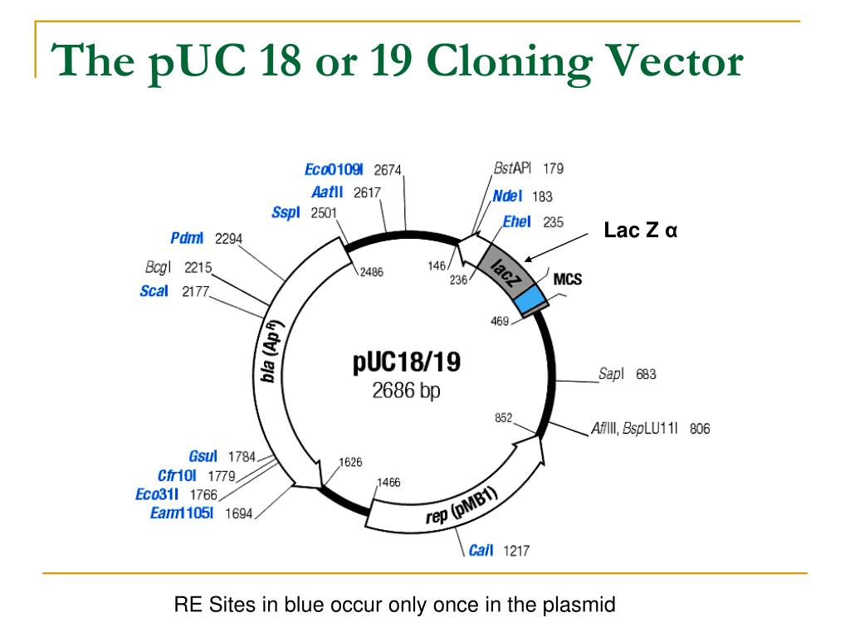

Slide 13
Expression vectors
The gene/cDNA coding for a potential target protein must be expressed at high levels.
This process involves insertion of the gene into a vector that will support high-level transcription and translation (Expression vector)
A wide range of such expression vectors are now commercially available and obviously each is tailored to work best in a specific host cell type (e.g. bacterial, yeast, mammalian).

Slide 14
Expression vectors
(P): tac promoter consisting of the –35 and –10 sequences, which are separated by a 17-base spacer.
(RBS): The ribosome binding site consists of the Shine–Dalgarno (SD) sequence followed by an AT-rich translational spacer that has an optimal length of approximately eight bases. The SD sequence interacts with the 3’ end of the 16S ribosomal RNA during translational initiation
Start codons: with the frequency of their usage in E. coli.
Stop codons: UAA followed by U is the most efficient translational-termination sequence in E. coli.
(R): repressor encoded by a regulatory gene (R) that modulates the activity of the promoter.
(TT): The transcription terminator serves to stabilize the mRNA and the vector
tet^{R}: an antibiotic-resistance gene (e.g. for tetracycline) facilitates phenotypic selection of the vector
Ori: the origin of replication (Ori) determines the vector copy number.
Hannig and Makrides (1998) focus

Slide 15
Overexpression of the target gene in the native host or heterologous host
Glazer & Nikaido, Microbial Biotechnology

Slide 16
Heterologous protein production in E. coli
The majority of recombinant proteins are produced in microbial systems, with E. coli being the most common expression system used.
Why E. coli?
Model organism for studying of prokaryotic genetics, the genetics of E. coli is known than any other microorganism.
Suitable plasmids are available, as were a variety of appropriate powerful and inducible promoters.
The majority of proteins synthesized naturally by E. coli are intracellular and the majority of heterologous proteins expressed in E. coli accumulate in the cell cytoplasm, where they can represent 25% or more of total cellular protein.

Slide 17
Heterologous protein production in E. coli

Slide 18
Inclusion body formation
Proteins expressed in E. coli sometimes accumulates in the cytoplasm in the form of insoluble aggregates termed inclusion bodies
Inclusion bodies are partially folded intermediates (often exhibiting stretches of intact secondary structure but little or no tertiary structure), and which are therefore obviously functionally inactive.
Inclusion body formed because of
Very high local concentrations of the expressed protein in the cytoplasm which may lead to precipitation
The presence of insufficient chaperones/folding enzymes
Prevention of formation of disulfide linkages due to the reducing environment of the cytoplasm
Lack of post-translational modifying enzymes may yield less stable (eukaryotic)

Slide 19
Recovery of proteins from Inclusion body

Slide 20
Production of soluble heterologous protein in E. coli
Empirical determination of exact optimal expression system: the host strain, plasmid, promoter sequence, . . etc..
Growth of recombinant cells below optimal growth temperatures: this slows the growth and division rate of the cells, thereby also reducing the rate of recombinant protein synthesis.
Enhancing the endogenous production of a cofactor (or exogenously providing the cofactor) can increase soluble yields of a recombinant protein which requires the cofactor concerned.
Co-expression of chaperones can improve soluble yield of heterologous protein.
Expression of the desired product as a fusion protein

Slide 21
Fusion Partners
Fusion to a (highly soluble) native host cytoplasmic protein enhances otherwise insoluble heterologous proteins.
In addition to that, expression levels of the recombinant protein construct increases.
Two of the more common fusion partners are maltose-binding protein (a 42-kDa protein encoded by the malE gene) and thioredoxin A (a 116-kDa cytoplasmic, highly soluble oxidoreductase enzyme).
Fusion partner approach does suffer from a number of potential drawbacks, including:
No fusion partner works universally to solubilize all proteins, and some proteins will remain insoluble no matter which tag is attached
Subsequent proteolytic tag removal may not be efficient (due to perhaps steric considerations);
The protein may not remain soluble once the tag is removed.

Slide 22
Fusion Partners
Hannig and Makrides (1998) focus

Slide 23
Extracellular production
Advantages of extracellular production of recombinant proteins in E. coli :
Ease of subsequent protein recovery and simplification of subsequent protein purification as E. coli exports very few proteins
Reduced likelihood of proteolytic degradation of the recombinant protein (E. coli produces many intracellular proteases but few extracellular proteases);
Increased likelihood of correct protein disulfide bond formation (disulfide bonds will not form in the cytoplasm due to its reducing chemical environment).

Slide 24
Extracellular production
Extracellular protein export from Gram-negative bacteria is complex in that it requires translocation through two membranes.
At least five different secretory transport systems have been identified
Type I and type II secretory systems predominate in E. coli, and both have been used in attempts to develop engineered strains capable of exporting recombinant protein extracellularly.
The type I secretory mechanism achieves a one-step transport of exported proteins across both membranes
Native proteins secreted via this system have a characteristic C-terminal targeting signal peptide sequence.
This signal sequence can be appended to recombinant proteins in order to facilitate their export via this transport mechanism.

Slide 25
The Type I secretory system

Slide 26
Extracellular production
Disadvantages of extracellular recombinant protein production from E. coli:
High-level recombinant protein expression usually overwhelms the secretory systems
The signal peptide can remain attached to the protein on its export (usually necessitating its subsequent removal from the purified recombinant protein).
The yield of true extracellular product is less than 1 g/L of fermentation media. In contrast, intracellular expression will often generate protein levels of 5–10g/L.

Slide 27
Genetic construct used to produce a secreted fusion protein
Bernard et al., (2010) Molecular biotechnology : principles and applications of recombinant DNA

Slide 28
Genetic construct used to produce a secreted fusion protein
Bernard et al., (2010) Molecular biotechnology : principles and applications of recombinant DNA

Slide 29
Integration of a cloned gene into a chromosomal site
In some cases, it is necessary to produce proteins from a cloned genes integrated into a chromosomal site to over come the following problems:
Avoid plasmid lose during cell growth, especially during pilot plant- or industrial-scale fermentations
For genetically engineered microorganisms that are designed to be released into the environment to remain both effective and environmentally safe, it is essential that the cloned DNA be retained and be neither easily lost nor transferred to other microorganisms.

Slide 30
Integration of a cloned gene into a chromosomal site
Integration of the cloned gene only
Integration of the whole plasmid
Bernard et al., (2010) Molecular biotechnology : principles and applications of recombinant DNA

Slide 32
E. coli cells can be engineered to secrete a foreign protein to the periplasm
By putting the bacteriocin release protein gene onto a plasmid under the control of a strong regulatable pro- moter, E. coli cells may be permeabilized at will.
E. coli cells that carry the bacteriocin release protein gene are transformed with another plasmid carrying a cloned gene that has been fused to a secretion signal peptide sequence.
Bernard et al., (2010) Molecular biotechnology : principles and applications of recombinant DNA

Slide 33
Hannig and Makrides (1998) focus

Slide 34
Heterologous production in bacteria other than E. coli
Other bacteria can be used as expression systems. Bacteria which are listed as GRAS (generally recognized as safe) serve as alternative production systems.
Heterologous proteins are produced in Gram-positive species of Streptomyces and bacilli. These are non-pathogenic, well characterized bacteria and secrete large quantities of protein extracellularly.
Approximately, 50% of commercially available industrial enzymes are produced by bacilli spp.
Considerable experience has also accumulated with regard to their industrial-scale culture and their genetic manipulation.

Slide 35
Metabolic Load
Expression of foreign DNA in a host organism often change the metabolism of the organism in ways that may impair normal cellular functioning. This phenomenon, is due to a metabolic load (metabolic burden; metabolic drain) that is imposed upon the host by the foreign DNA and can occur because of the following.
An increasing plasmid copy number and/or size requires increasing amounts of cellular energy for plasmid replication and maintenance.
The limited amount of dissolved oxygen in the growth medium
Overproduction of both target and marker proteins may deplete the pools of certain aminoacyl-tRNAs (or even certain amino acids) and/or drain the host cell of its energy (in the form of ATP or GTP).
When a foreign protein is overexpressed and then exported from the cytoplasm to the cell membrane, the periplasm, or the external medium, it may “jam” export sites and thereby prevent the proper localization of other, essential host cell proteins.
The foreign protein per se may interfere with the functioning of the host cell.
Bernard et al., (2010) Molecular biotechnology : principles and applications of recombinant DNA

Slide 36
Heterologous protein production in yeast

Slide 37
Saccharomyces cerevisiae
There are three main classes of S. cerevisiae expression vectors:
Yeast episomal plasmids (YEps).
Yeast integrating plasmids (YIps)
Yeast artificial chromosomes (YACs)
Yeast episomal plasmids have been used extensively for the production of either intra- or extracellular heterologous proteins.
Typically, vectors function in both E. coli and S. cerevisiae.

Slide 38
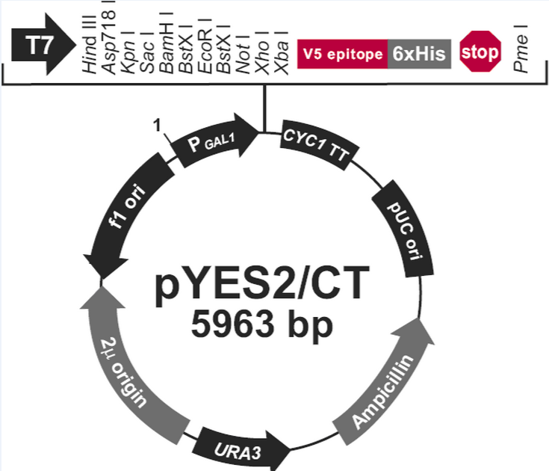
Heterologous protein production in yeast by Ylps
URA3: Auxotropic marker GAL1: Galactose inducible promoter
CYC1 TT: Terminator
Amp^{R}: Ampiccilin resistance gene
pUC ori: origin of replication (E. coli)
2µ: origin of replication (Yeast)
CEN: Centromere is required for segregation of chromosomes during mitosis
ARS: is the origin of replication in the yeast genome

Slide 39
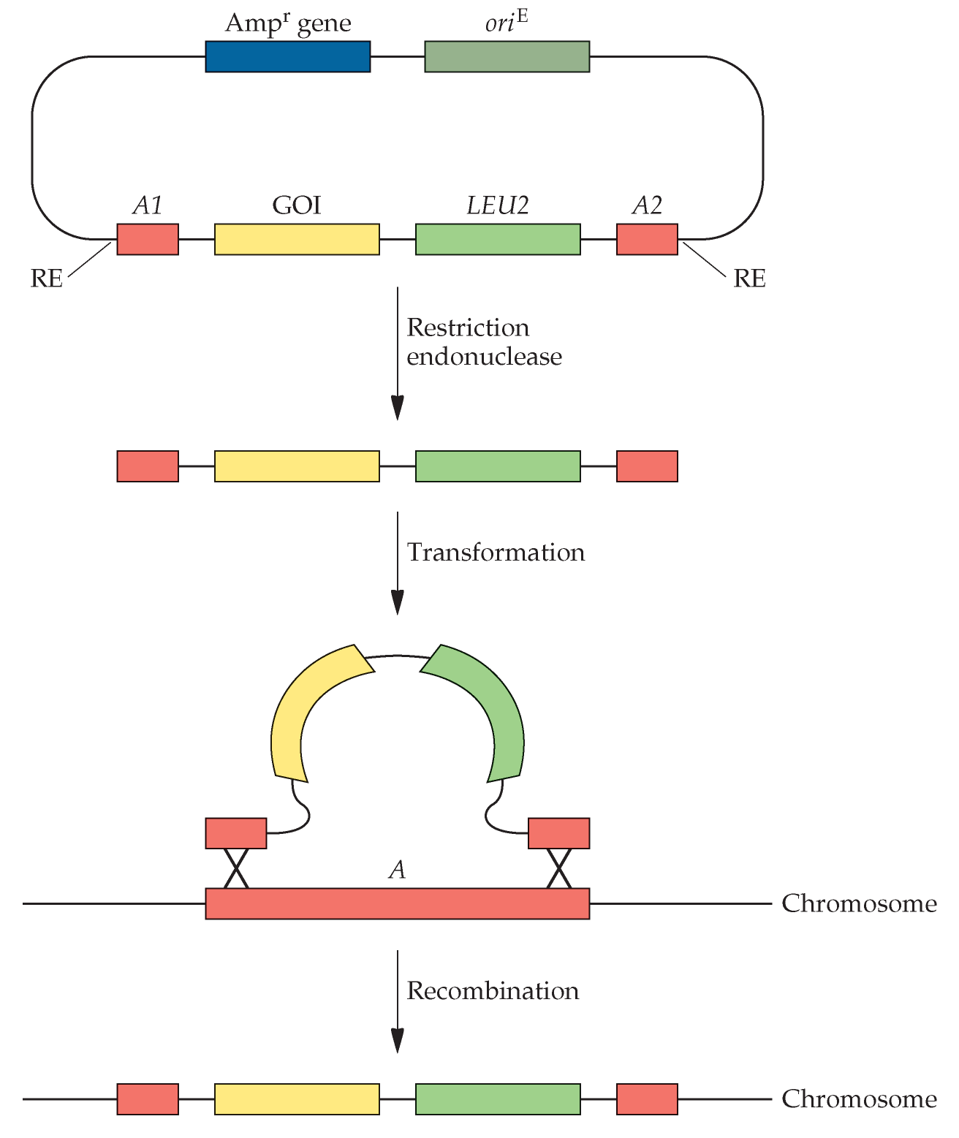
Integration of DNA with a Yip vector
Bernard et al., (2010) Molecular biotechnology : principles and applications of recombinant DNA

Slide 40
Heterologous production in yeast
While Saccharomyces cerevisiae remains the most popular yeast host, several other yeasts are also utilized in the production of heterologous proteins.
Pichia pastoris is among a limited number of yeasts capable of utilizing methanol as sole carbon source.
Its methanol utilization pathway contains two alcohol oxidise genes (AOX1 and AOX2) and AOX1 protein levels in particular can reach over 30% of total soluble protein in the cell.
AOX1 expression is under the control of a strong and tightly regulated AOX1 promoter, and this promoter is used in recombinant systems to drive high-level protein synthesis
Such recombinant systems are also usually designed so as to incorporate a protein export sequence on the recombinant protein, thus ensuring its extracellular export which simplifies subsequent protein recovery.

Slide 41
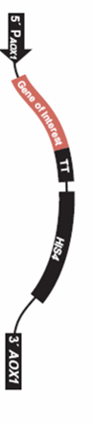
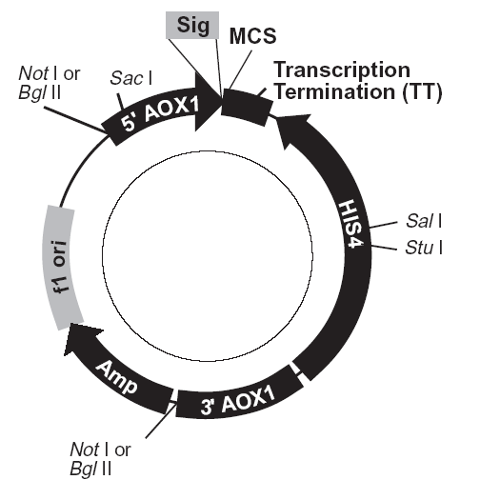
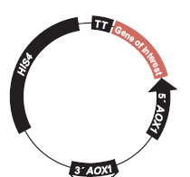
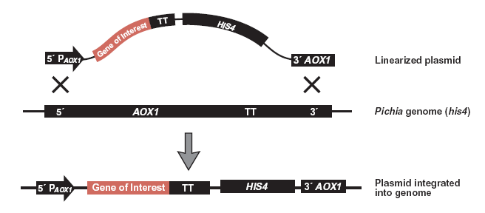
Pichia Cloning
Thermo Fisher

Slide 42
Heterologous protein production in fungi
Fungai such as Aspergillus niger and Aspergillus oryzae naturally produce various extracellular enzymes at very high levels (up to 20g/L) and many of these enzymes (cellulases, amylases, proteases, phytases and lipases) have been commercialized.
Advantages of using fungi for heterologous gene expression:
Many are GRAS listed and many produce non-recombinant enzymes as well as other primary and secondary products of metabolism (e.g. vitamins, various organic acids, antibiotics and alkaloids).
Large- scale fermentation systems are developed and optimized.
They have an unparalleled natural capacity to secret large quantities of certain proteins into the extracellular medium.
They possess the enzymatic capability to carry out PTMs (although, their glycosylation capacity differs from that characteristic of mammalian cells)

Slide 43
Heterologous protein production in fungi
Construct for expression and secretion of the human a1-proteinase inhibitor in the filamentous fungus A. niger. The expression cassette includes the strong constitutive promoter gpdAp, the transcriptional terminator from the TrpC gene (TrpCt), the cDNA encoding glucoamylase to facilitate secretion, and the coding sequence for the Kex2 recognition site for in vivo removal of the glucoamy lase fusion protein by the host Kex2 endoprotease.
Bernard et al., (2010) Molecular biotechnology : principles and applications of recombinant DNA

